Slide 1

PRESENTED BY: WFS HYD 2 TEAM 2
BUG TRACKING SYSTEM
TEAM NAME: BUG IT OUT

Slide 2
What is a Bug?
Agenda
1
Project Scope
2
Project Modules
3
UML & ER diagrams
4
Project Screenshots
5

Slide 3

WHAT IS A BUG?
A bug is an unexpected problem with software or hardware. Typical problems are often the result of external interference with the program’s performance that was not anticipated by the developer. Minor bugs can cause small problems like frozen screens or unexplained error messages that do not significantly affect usage. Major bugs may not only affect software and hardware, but could also have unintended effects on connected devices or integrated software and may damage data files.

Slide 4

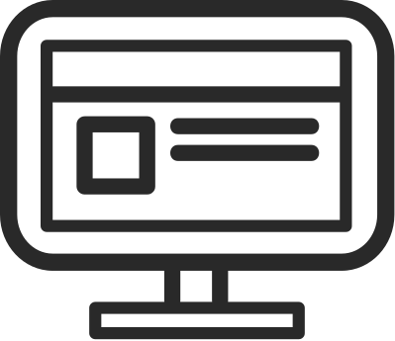

Project Scope
PROJECT CONSTRAINTS & ASSUMPTIONS
FUNCTIONAL SCOPE
NON-FUNCTIONAL SCOPE
The bug tracking system will provide a user-friendly web-based interface accessible to both developers and QA teams.
Users will be able to log in, create, updatebugs as per their authentication controls.
The system will be highly available and responsive, ensuring minimal downtime.
Security measures, including user authentication, authorization, and data encryption, will be in place to protect sensitive bug-related information.
Integration with existing tools and systems, such as version control, project management, and continuous integration tools, will be considered and may require additional effort.It is assumed that the organization will provide the necessary hardware and infrastructure to host the bug tracking system

Slide 5
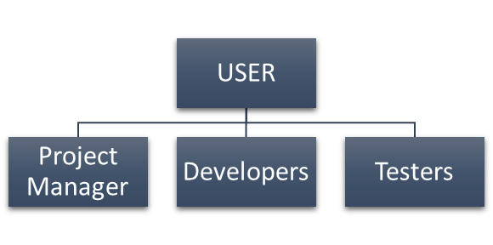
PROJECT MODULES
There will be three kind of users, Project Manager, Developers and Testers.
Each will have a UID, Name, email, Type of user attributes

Slide 6
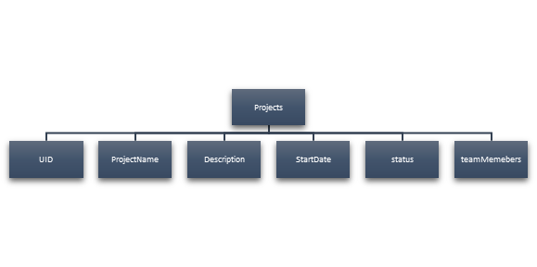
PROJECT MODULES
Apart from this a team will consist of the follwing members
a single project manager
multiple developers
a single tester

Slide 7
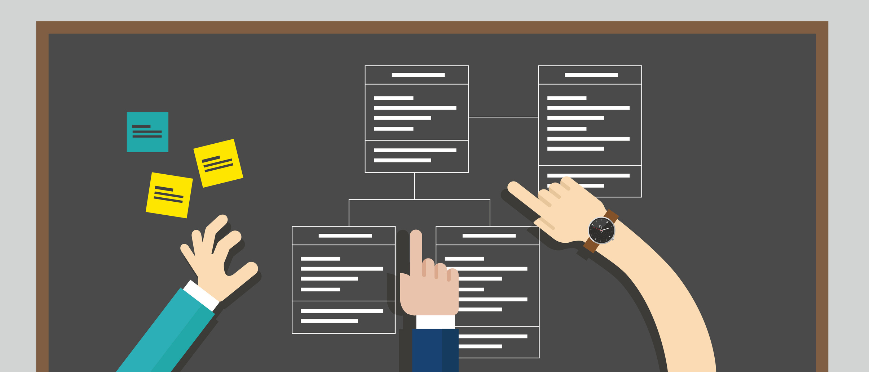
UML DIAGRAMS
The elements are like components which can be associated in different ways to make a complete UML picture, which is known as a diagram. Thus, it is very important to understand the different diagrams to implement the knowledge in real-life systems.
Any complex system is best understood by making some kind of diagrams or pictures. These diagrams have a better impact on our understanding. If we look around, we will realize that diagrams are not a new concept but it is used widely in different forms in different industries.
We prepare UML diagrams to understand the system in a better and simple way. A single diagram is not enough to cover all the aspects of the system. UML defines various kinds of diagrams to cover most of the aspects of a system.

Slide 8
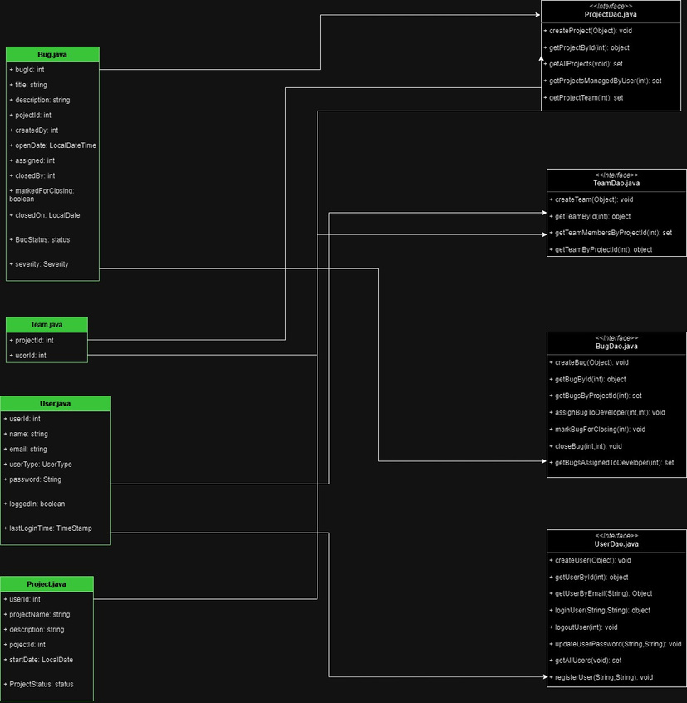
Class Diagram for the project
Here we have shown all the beans classes along with the dao and their interconnection

Slide 9
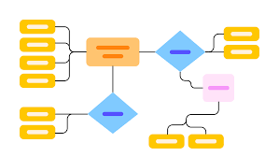
ER DIAGRAMS
An Entity Relationship (ER) Diagram is a type of flowchart that illustrates how “entities” such as people, objects or concepts relate to each other within a system. ER Diagrams are most often used to design or debug relational databases in the fields of software engineering, business information systems, education and research. Also known as ERDs or ER Models, they use a defined set of symbols such as rectangles, diamonds, ovals and connecting lines to depict the interconnectedness of entities, relationships and their attributes. They mirror grammatical structure, with entities as nouns and relationships as verbs.

Slide 10
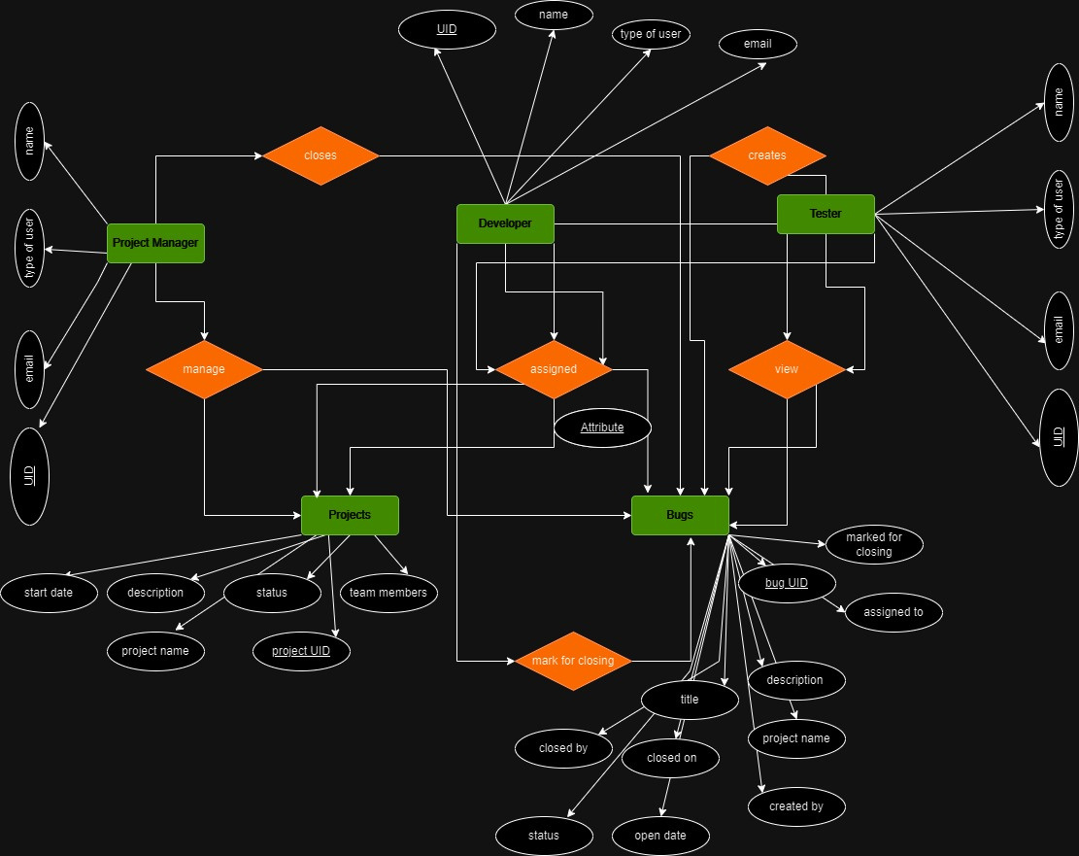
ERDiagram for the project
Here we have shown all the entities, their attributes and relationships among them

Slide 11
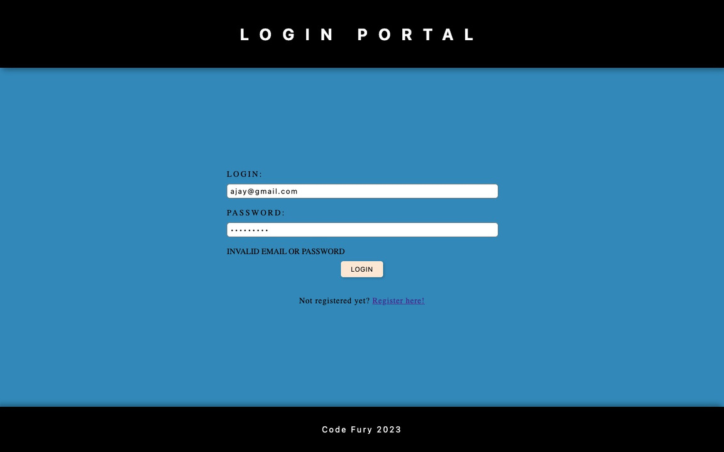
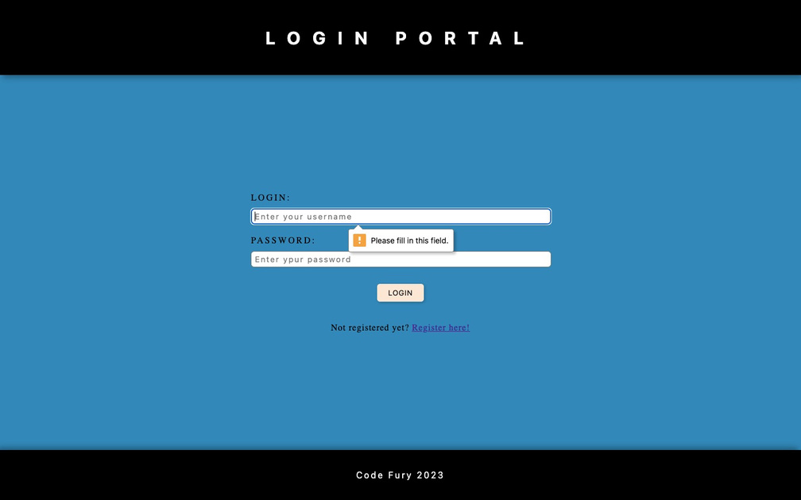
Project Screenshots
Login Page

Slide 12
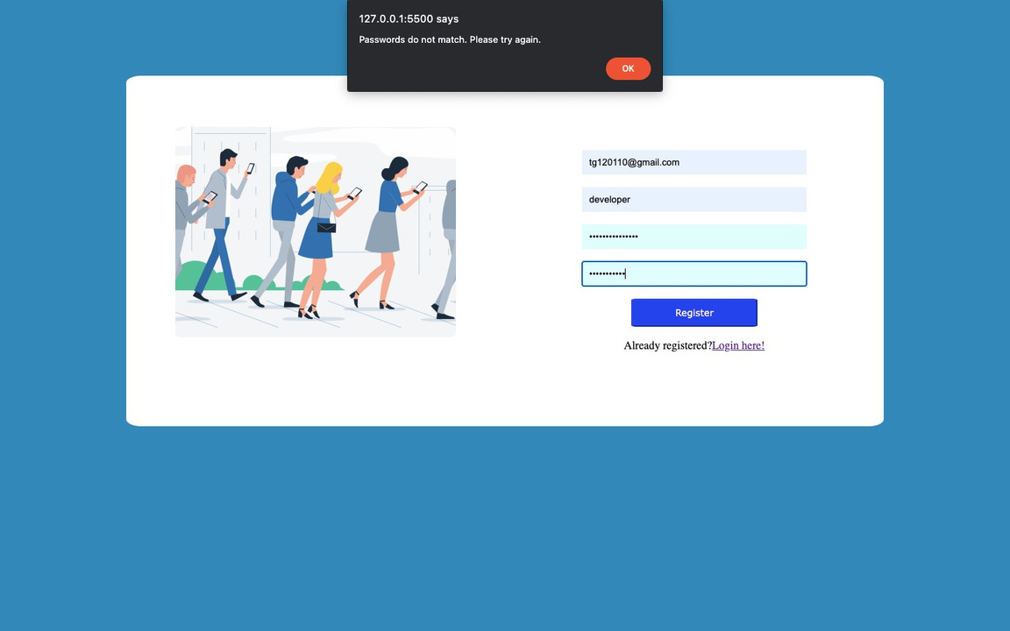
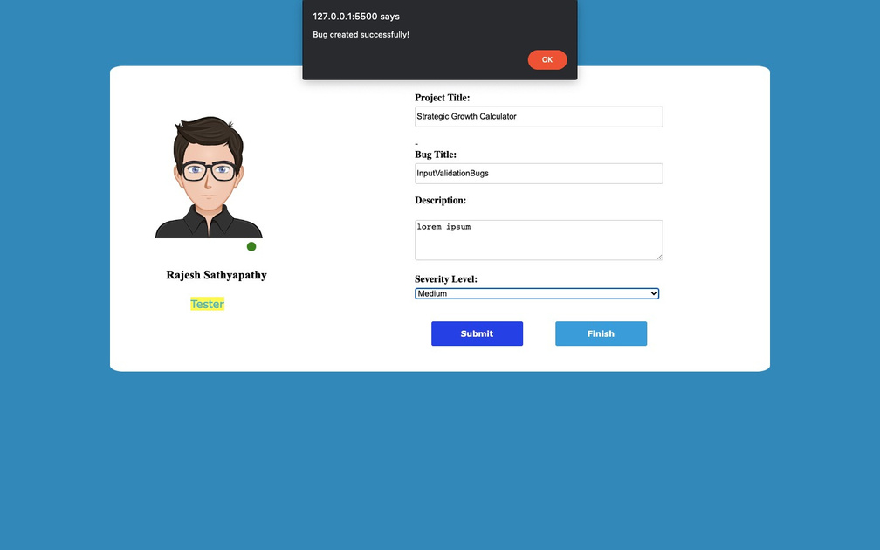
Project Screenshots

Slide 13
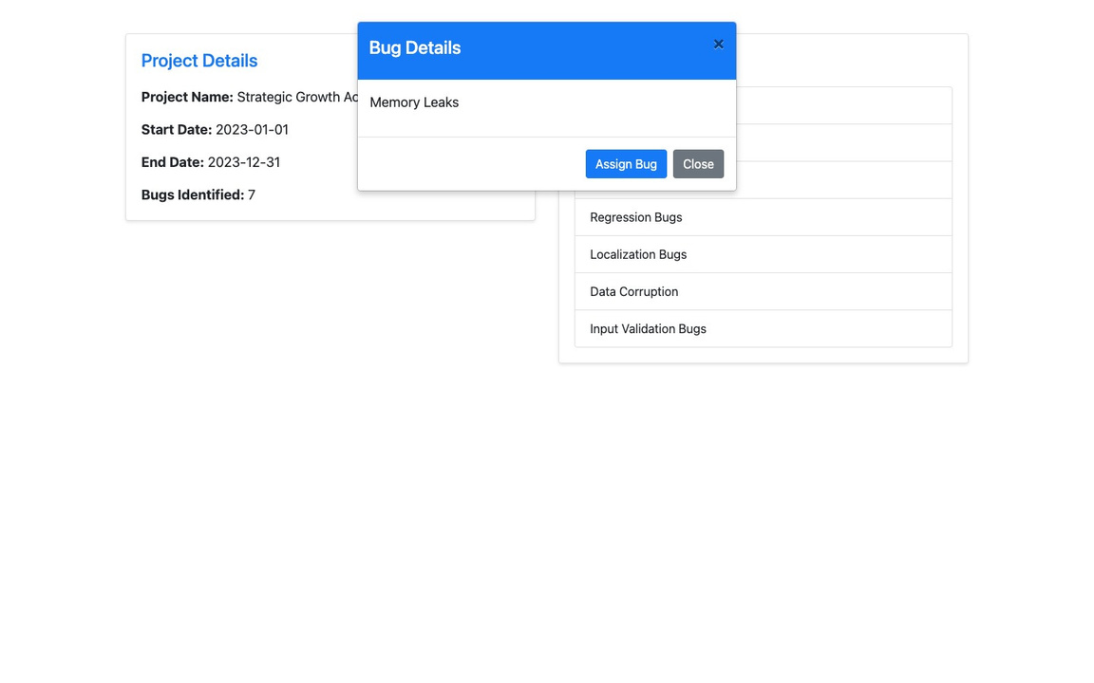
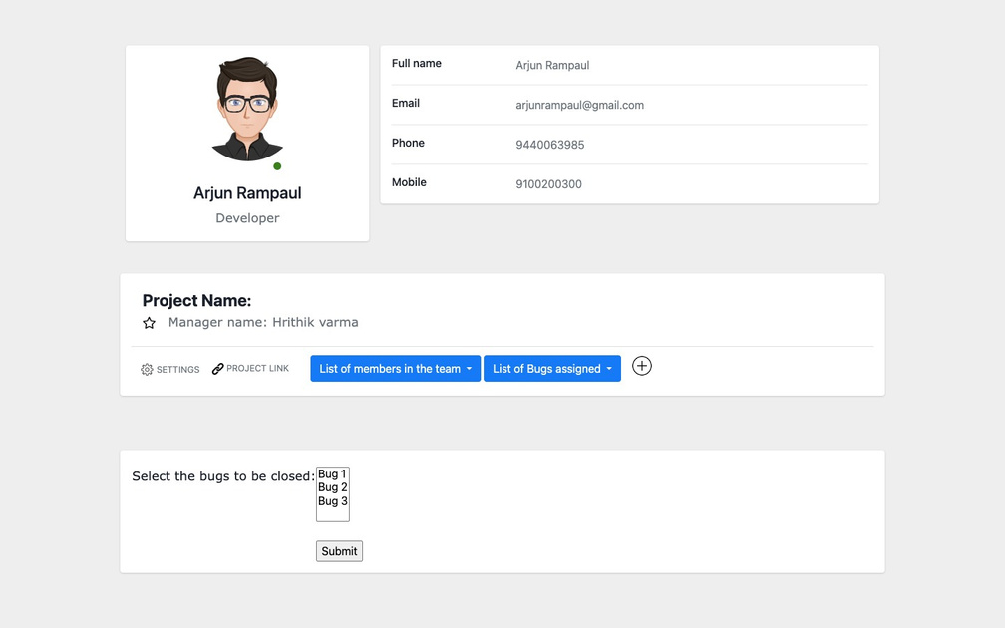
Project Screenshots

Slide 14
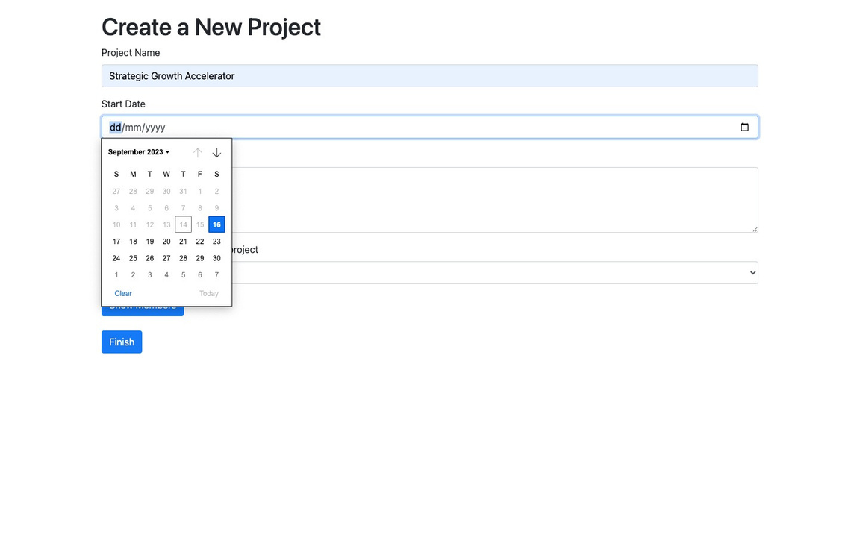
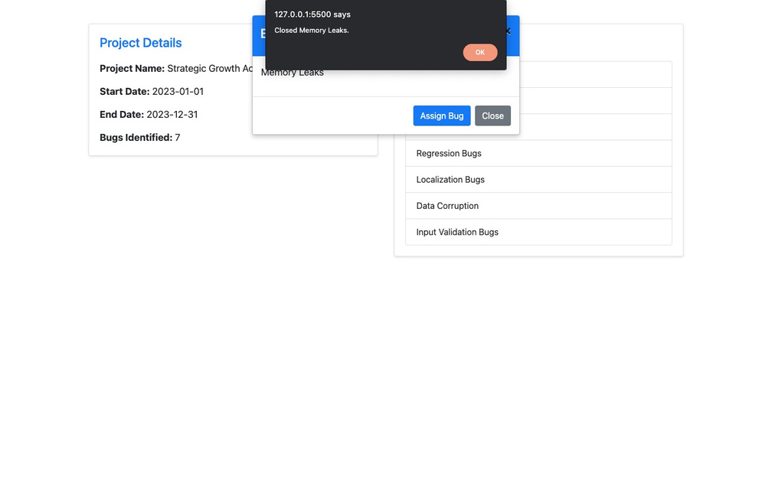
Project Screenshots

Slide 15
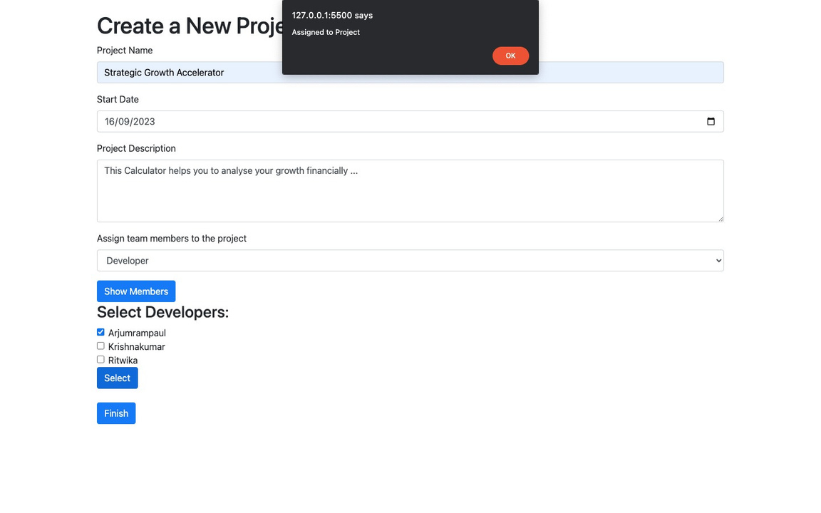
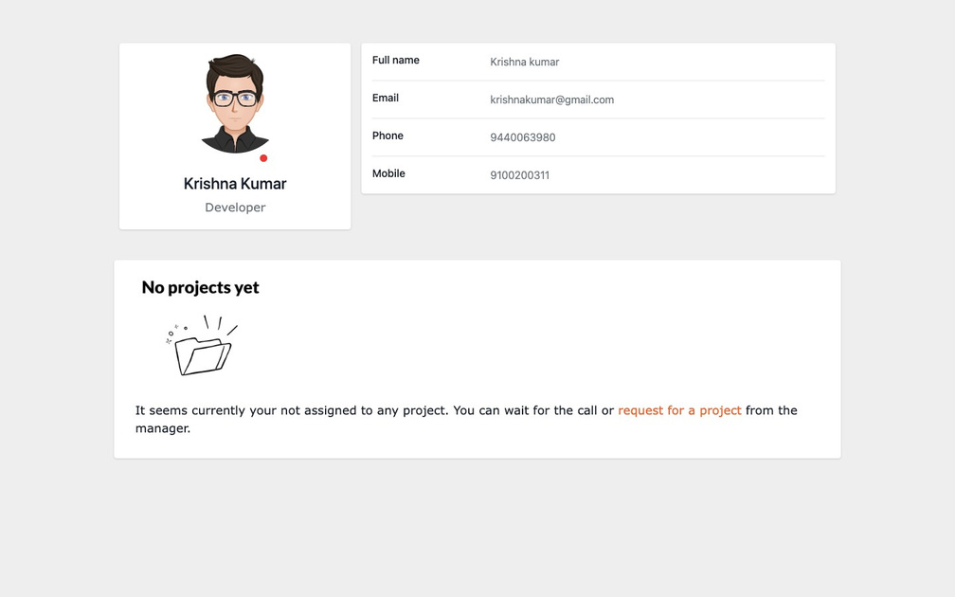
Project Screenshots

Slide 16
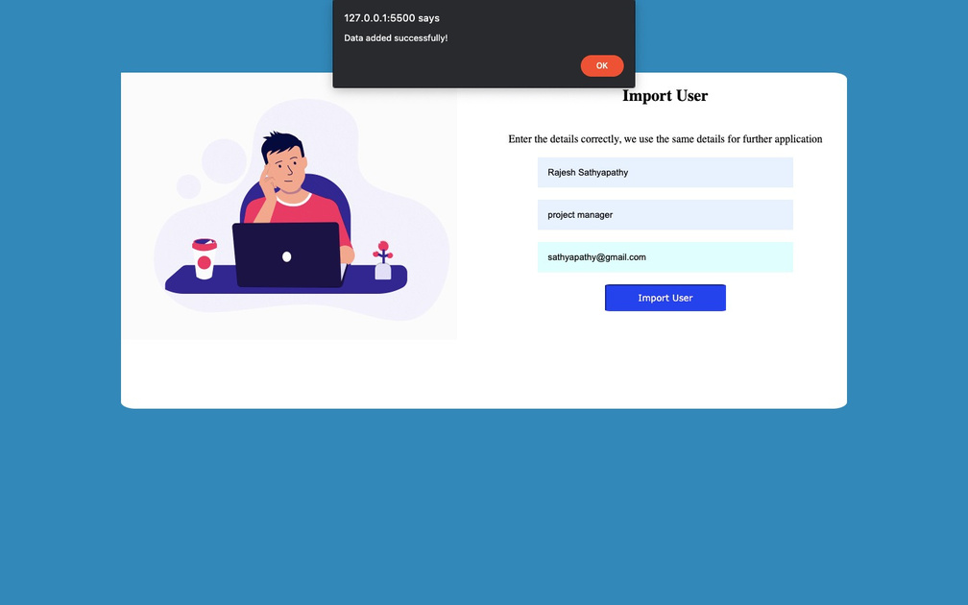
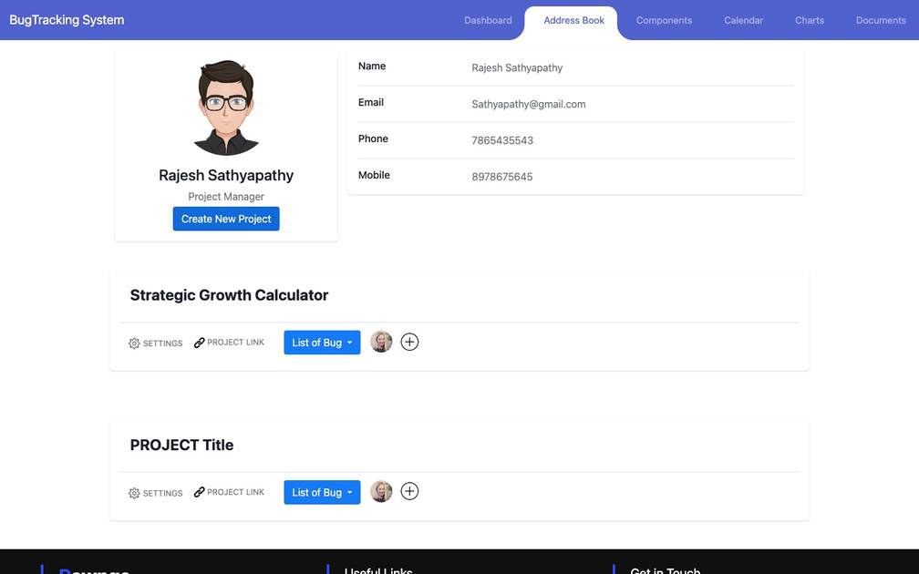
Project Screenshots

Slide 17
Thank you!

